Slide 1
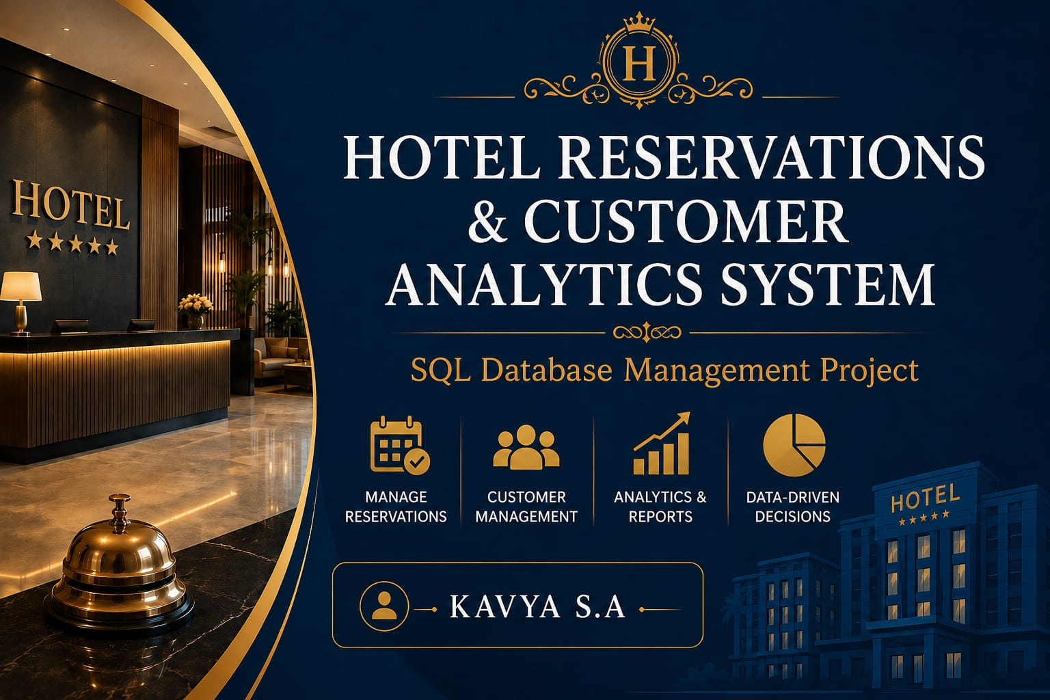

Slide 2
INTRODUCTION
The Hotel Reservations & Customer Analytics System is a SQL database project designed to manage hotel operations efficiently.
It stores customer details, room information, reservations, and payment records in a centralized database.
The system automates booking, check-in, check-out, and customer record management, reducing manual work.
It generates reports and analytics on occupancy, revenue, customer preferences, and booking trends.
The project helps hotel management improve decision-making, enhance customer satisfaction, and increase operational efficiency.

Slide 3
OBJECTIVES
Manage Hotel Reservations Efficiently handle room bookings, check-in, and check-out.
Maintain Customer Information Store customer details and booking history securely.
Automate Booking & Payment Simplify reservation and payment processes.
Generate Analytics & Reports Create occupancy, revenue, and customer reports.
Support Data-Driven Decisions Improve hotel performance through analytics.

Slide 4
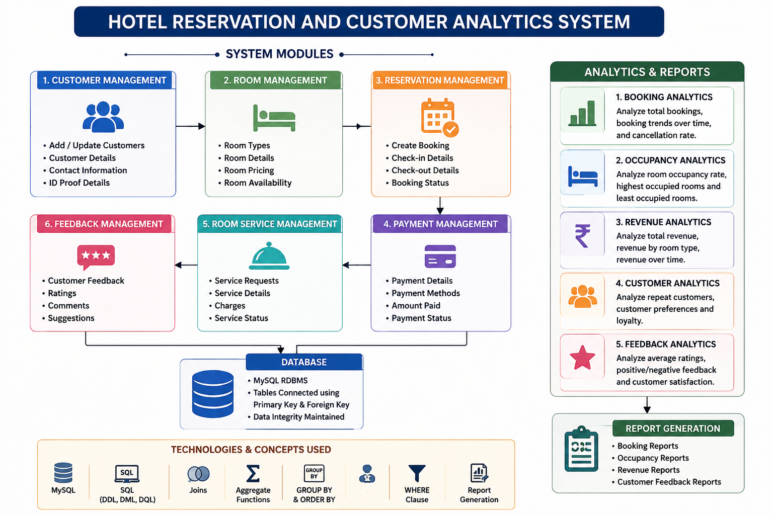
PROJECT EXPLANATION

Slide 5
Tables used
TABLE | PURPOSE
Customers | Customer Details
Rooms | Room Information
Reservations | Booking Details
Payments | Payment Records
Employees | Staff Information
Feedback | Customer Reviews
Room Services | Additional Services
Table | Purpose
Customers | Customer Details
Rooms | Room Information
Reservations | Booking Details
Payments | Payment Records
Employees | Staff Information
Feedback | Customer Reviews
Room Services | Additional Services

Slide 6
CONCEPTS
Database Management System (DBMS)
SQL (Structured Query Language)
SQL Queries (DDL, DML)
Table Creation (DDL Commands)
Primary Key & Foreign Key
Joins(for combining data from multiple tables)
Aggregate Functions (COUNT, SUM, AVG)
Group by and Order by
Report Generation

Slide 7
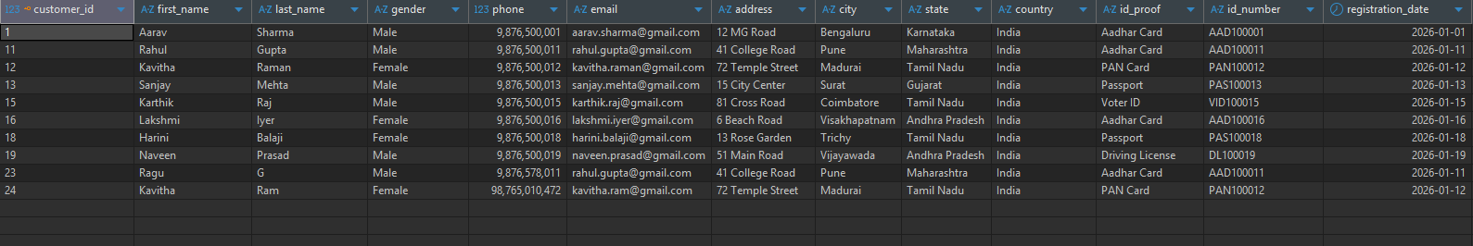
Queries Performed
Search Customer:
select*from customers where first_name like'_a%__';

Slide 8
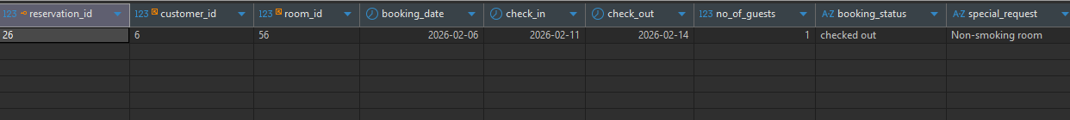
Check in check out
update reservations set booking_status='checked out' where room_id=56;
select*from reservations where room_id=56;

Slide 9
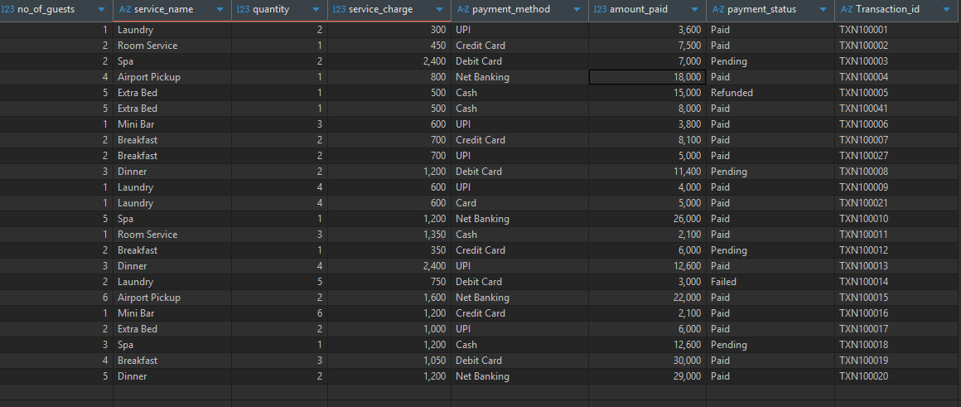
BILL GENERATION
select
p.payment_id,
p.payment_date,
c.customer_id,
concat(c.first_name,'',c.last_name)as customer_name,
from customers c
join reservations r
on c.customer_id=r.customer_id
join rooms rm
on rm.room_id=r.room_id
join room_services rs
on r.reservation_id=rs.reservation_id
join payments p
on p.reservation_id=r.reservation_id;

Slide 10
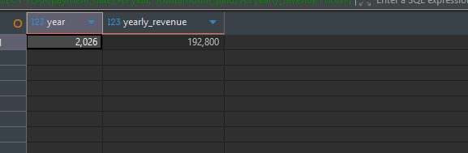
YEARLY REVENUE
SELECT
YEAR(payment_date) AS year,
SUM(amount_paid) AS yearly_revenue
FROM payments
WHERE payment_status = 'Paid'
GROUP BY YEAR(payment_date)
ORDER BY YEAR(payment_date);

Slide 11
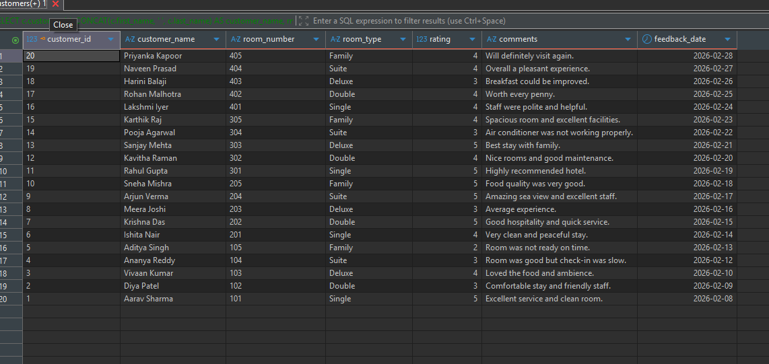
Customer Review REPORT
SELECT
c.customer_id,
CONCAT(c.first_name, ' ', c.last_name) AS customer_name,
rm.room_number,
rm.room_type,
f.rating,
f.comments,
f.feedback_date
FROM feedback f
JOIN customers c
ON f.customer_id = c.customer_id
JOIN reservations r
ON f.reservation_id = r.reservation_id
JOIN rooms rm
ON r.room_id = rm.room_id
ORDER BY f.feedback_date desc;

Slide 12
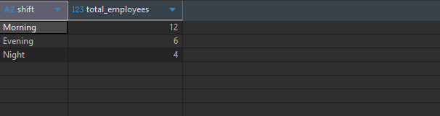
Shift-wise Employees
SELECT
shift,
count(employee_id) as total_employees
FROM employees
GROUP BY shift
ORDER by total_employees DESC;

Slide 13
ADVANTAGES
Automates hotel reservation and booking processes.
Stores customer data securely in a centralized database.
Generates reports for occupancy, revenue, and customer trends.
Reduces manual work and minimizes errors.
Improves customer satisfaction through faster service.

Slide 14
DISADVANTAGES
Requires regular database maintenance and updates.
Initial setup and implementation can be costly.
System failure may affect hotel operations.
Requires trained staff to operate the system.
Data security risks if proper protection is not implemented

Slide 15
FUTURE ENCHANCEMENT
AI-Based Customer Recommendations Recommend rooms and services based on customer preferences.
Mobile App Integration Enable customers to book rooms, check in, and make payments using a mobile app.
Cloud Database Support Store data securely in the cloud for easy access and backup.
Online Payment Gateway Integration Support secure online payments through UPI, cards, and digital wallets.

Slide 16
Q&A

Slide 17
Thank you

